Slide 1
Structures
CS201

Slide 2
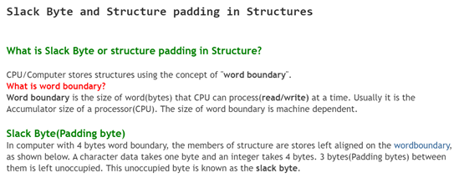

Slide 3
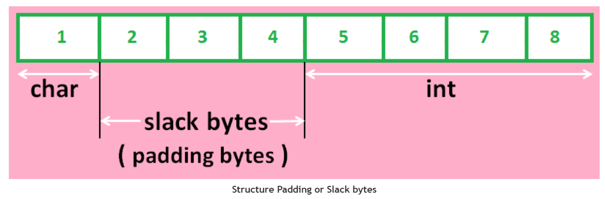

Slide 4
Why Padding or slack bytes are required?
Slack byte used for speed optimization. It aligns bytes so that, that can be read/write from structure faster. It is an extra byte, sometimes placed between structure members to align the structure.
Some Platforms like x86, CPU can access data aligned on absolutely any boundary, not only on "word boundary". The mis-aligned access might be less efficient than aligned access. If data is aligned properly, CPU can access the memory(structure members) efficiently and faster.
Note: As far as CPU is concerned, it can access any data on any boundary.
When we declare structure variables, each one of them may contain the slack bytes and the values stored in such slack bytes are undefined(garbage). Due to this, even though the members of two variable values are equal, their structures do not necessarily to be equal. Therefore C does not permit compassion of structures. However, we need to design our own function that can compare the individual members of structure to decide whether the structures are equal or not.

Slide 5
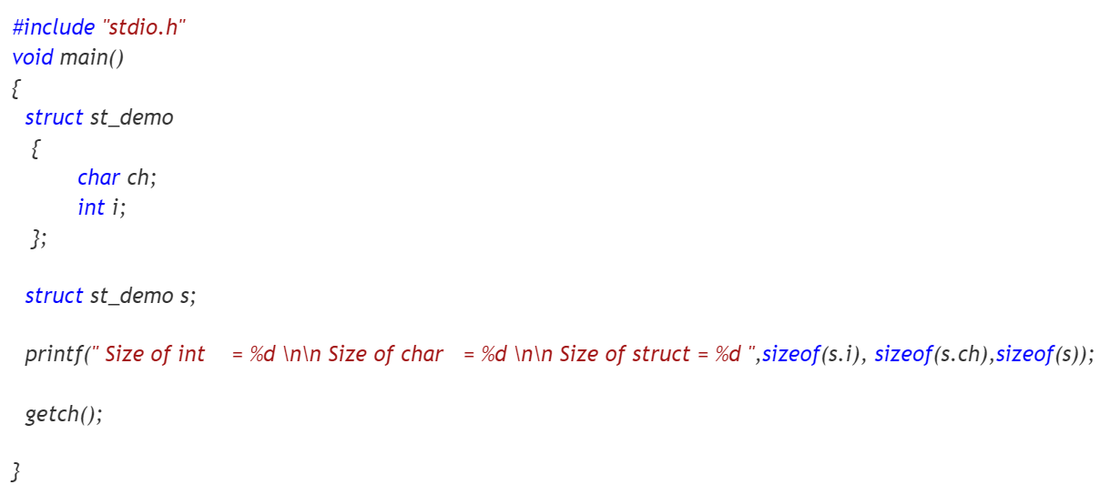

Slide 6
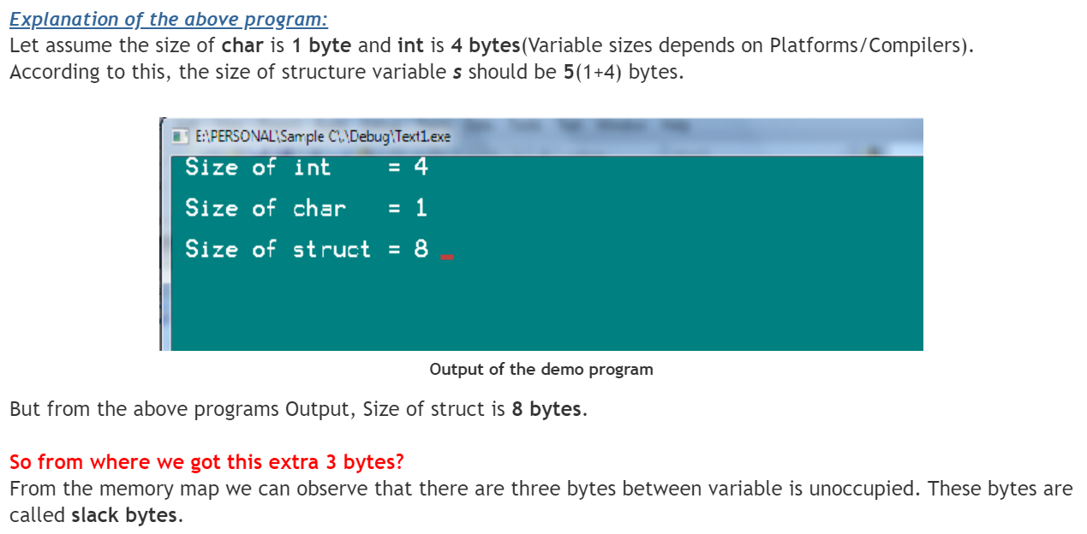

Slide 7
Self Referential Structures
Self Referential structures are those structures that have one or more pointers which point to the same type of structure, as their member.

Slide 8
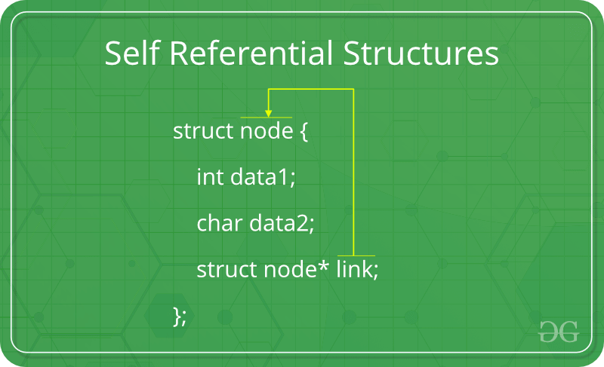

Slide 9
Single link
struct node {
int data1;
char data2;
struct node* link;
};

Slide 10
Types of Self Referential Structures
Self Referential Structure with Single Link
Self Referential Structure with Multiple Links

Slide 11
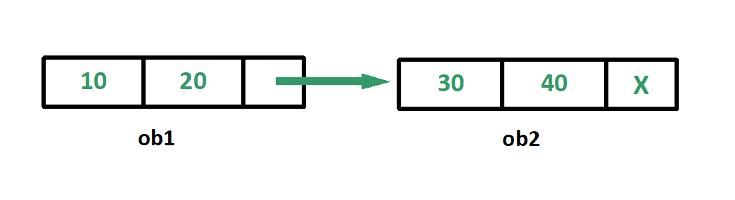
Self Referential Structure with Single Link
These structures can have only one self-pointer as their member. The following example will show us how to connect the objects of a self-referential structure with the single link and access the corresponding data members. The connection formed is shown in the following figure.

Slide 12
Multiple link
struct node {
int data1;
char data2;
struct node* link1;
struct node* link2;
};

Slide 13
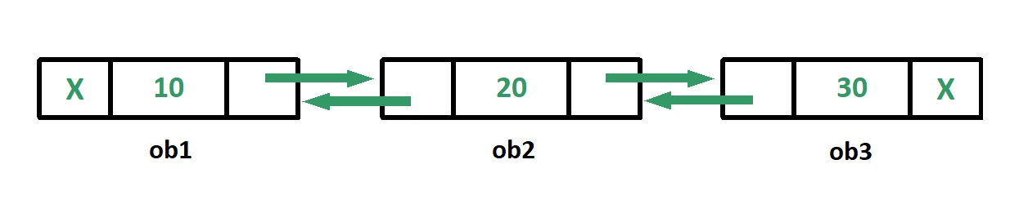
Self Referential Structure with Multiple Links
Self referential structures with multiple links can have more than one self-pointers. Many complicated data structures can be easily constructed using these structures. Such structures can easily connect to more than one nodes at a time. The following example shows one such structure with more than one links.

Slide 14
Applications of self referential structures:
1. Linked list
2. Tree
3. Graphs

Slide 15
References
1. http://neentech.blogspot.com/
2. https://www.geeksforgeeks.org/

